Slide 1
Exploratory Data Analysis On Video Game Sales
Jainam Shah (18162121033)

Slide 2
Introduction
The dataset provided to perform exploratory data analysis on video game sales includes the following fields.
Rank - Ranking of overall sales
Name - The games name
Platform - Platform of the games release (i.e. PC,PS4,DS etc.)
Year - Year of the game's release
Genre - Genre of the game
Publisher - Publisher of the game
NA_Sales - Sales in North America (in millions)
EU_Sales - Sales in Europe (in millions)
JP_Sales - Sales in Japan (in millions)
Other_Sales - Sales in the rest of the world (in millions)
Global_Sales - Total worldwide sales.

Slide 3
Graphics And Insights
Exploratory Data Analysis on the given dataset has been performed using IBM COGNOS and graphics are displayed using DASHBOARD of COGNOS.
Precise insights are given on :
Game sales throughout the years
Most game genre preferred by users
Most successful platforms and publishers
Most played Games worldwide
Longest running successful games.

Slide 4
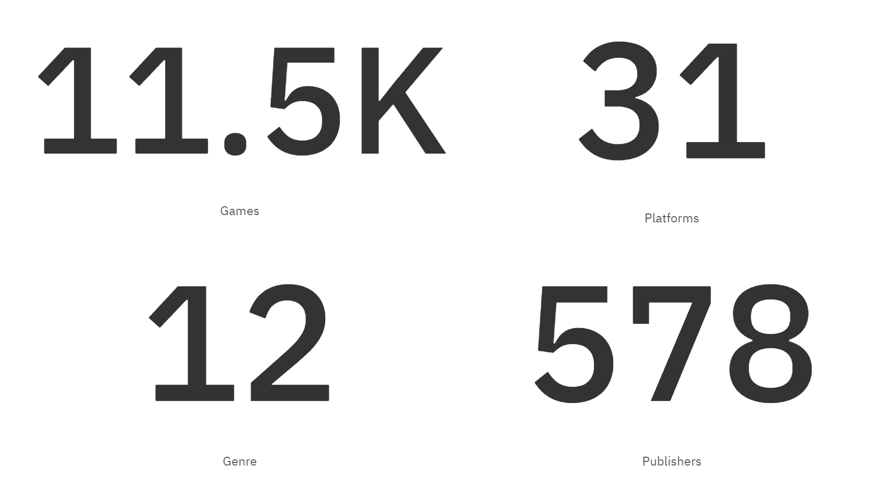
1. Overview

Slide 5
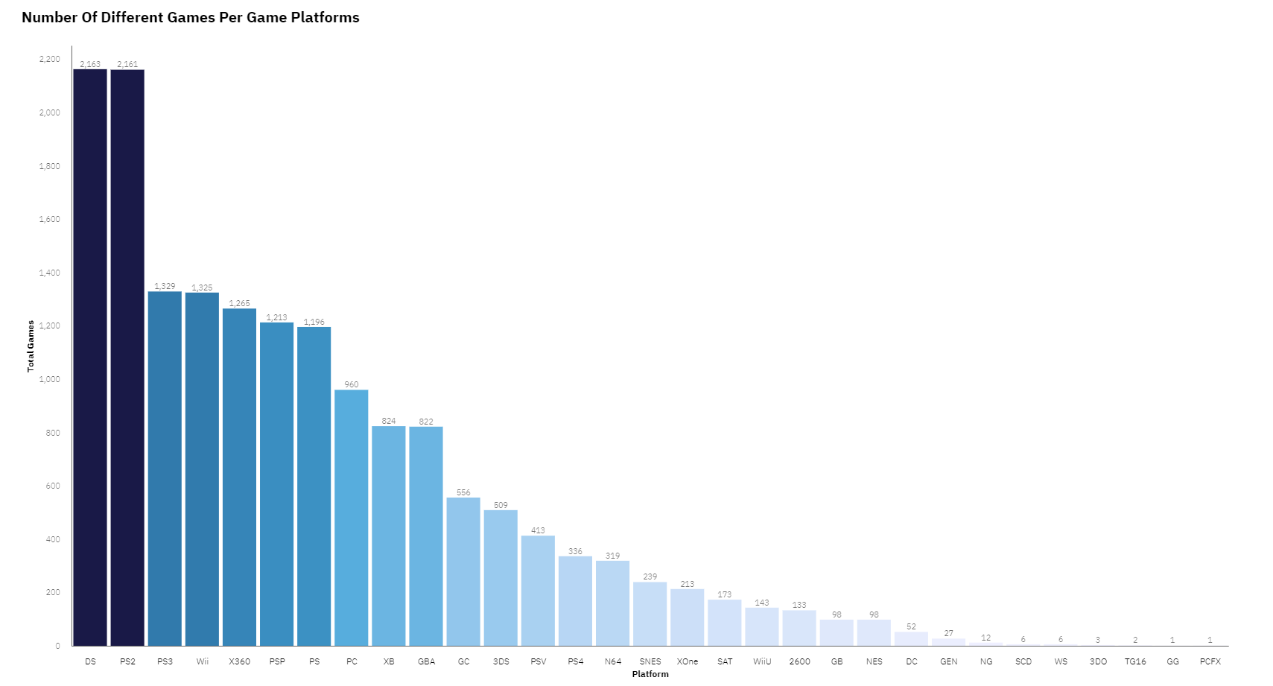
2.Game Platforms

Slide 6
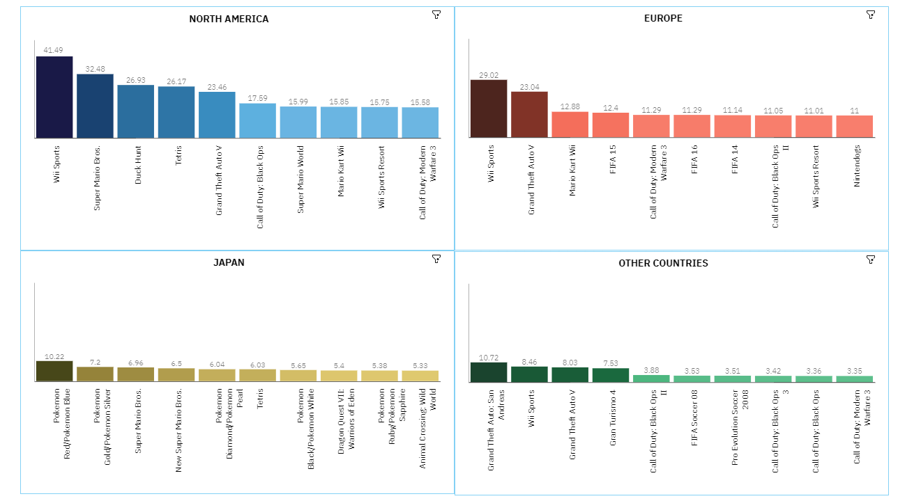
3. Games

Slide 7
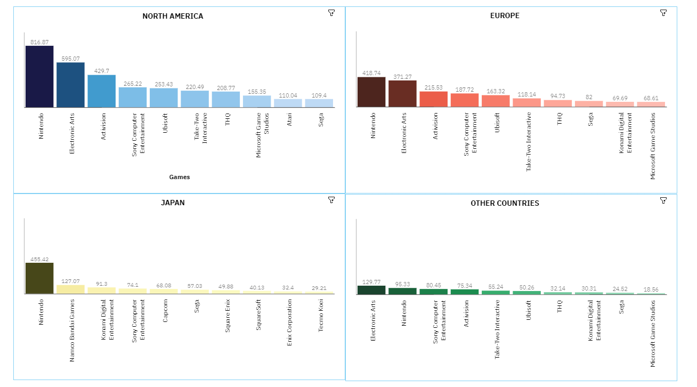
4. Publishers

Slide 8
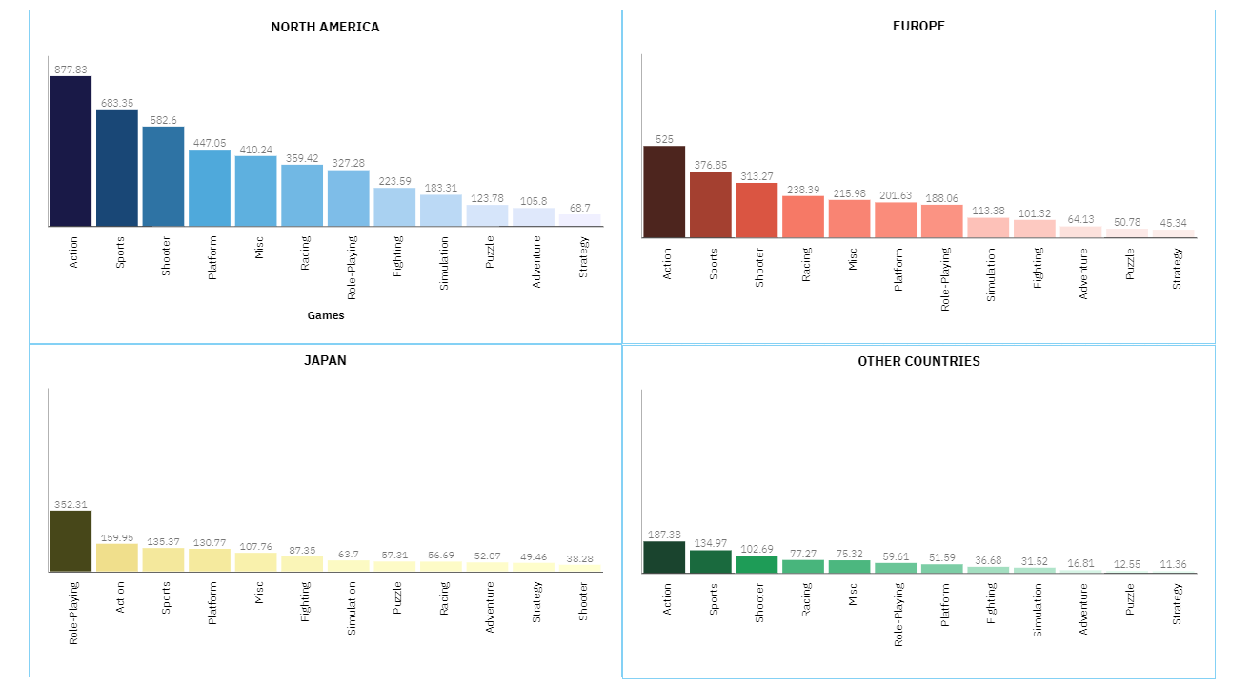
5.Genre (Region Wise)

Slide 9
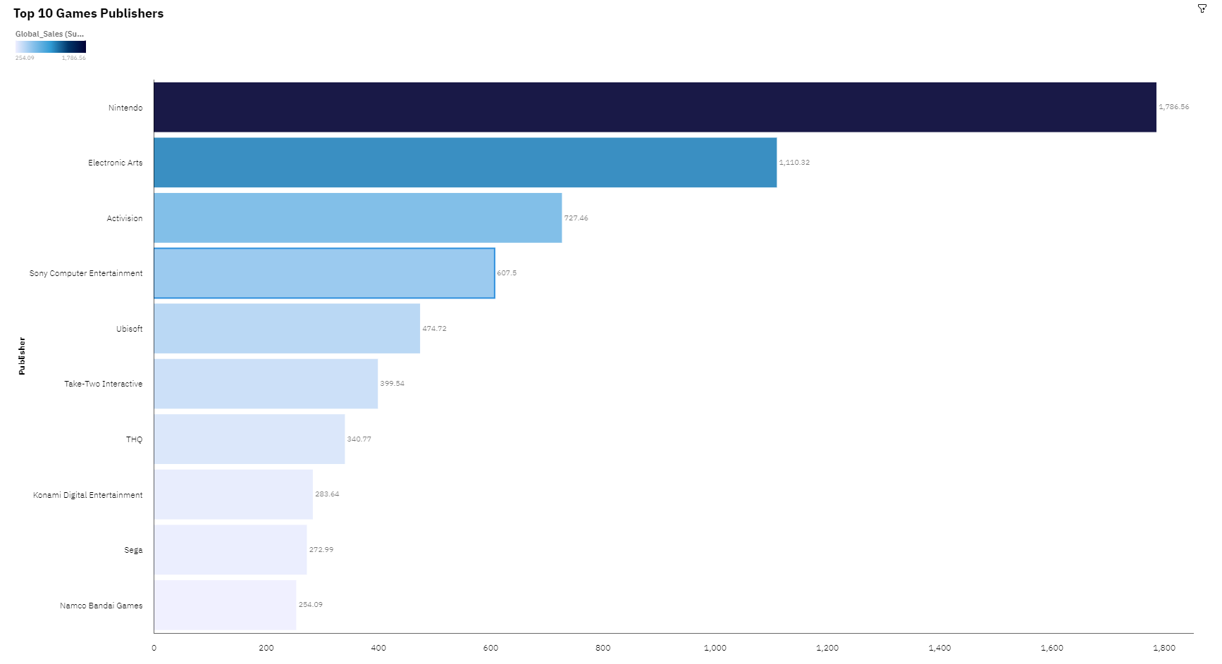
6.Publishers (Worldwide)

Slide 10
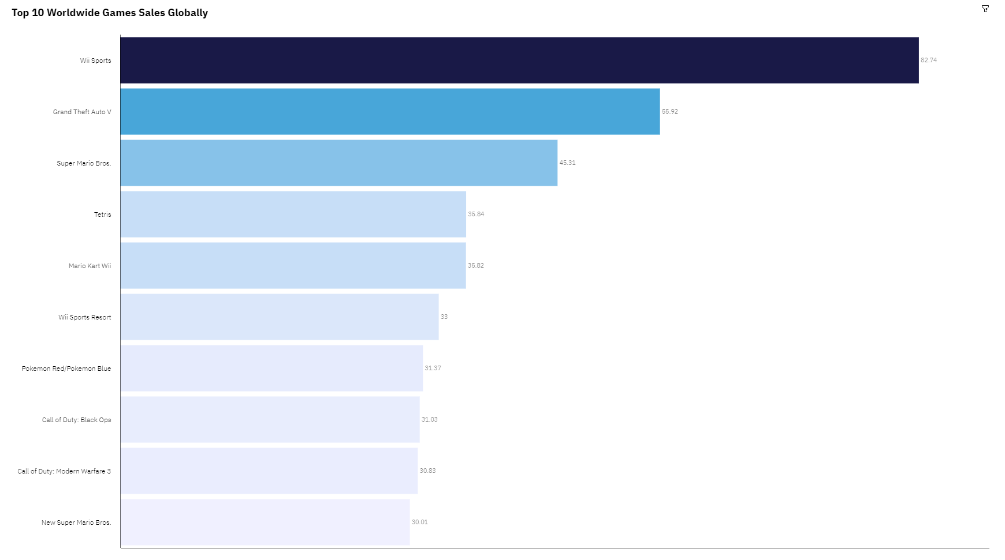
7. Games (Worldwide)

Slide 11
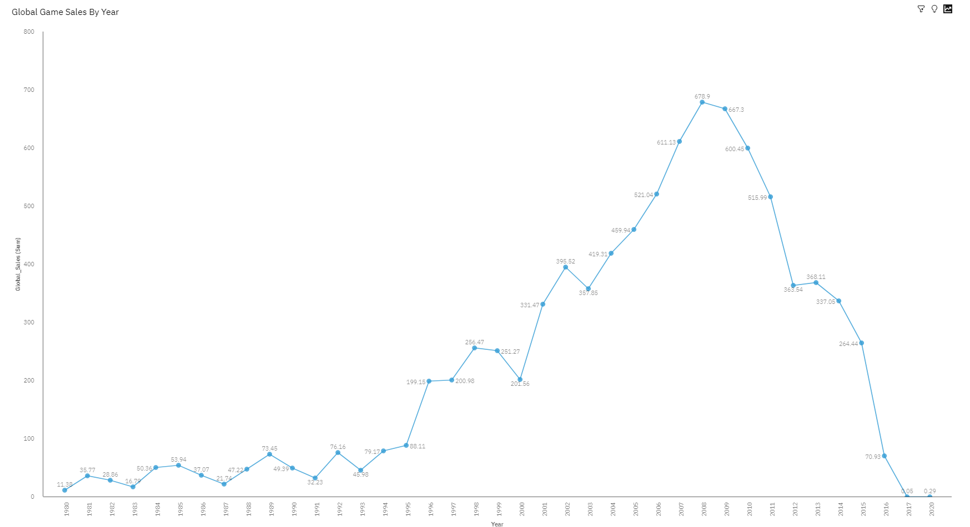
8.Game Sales

Slide 12
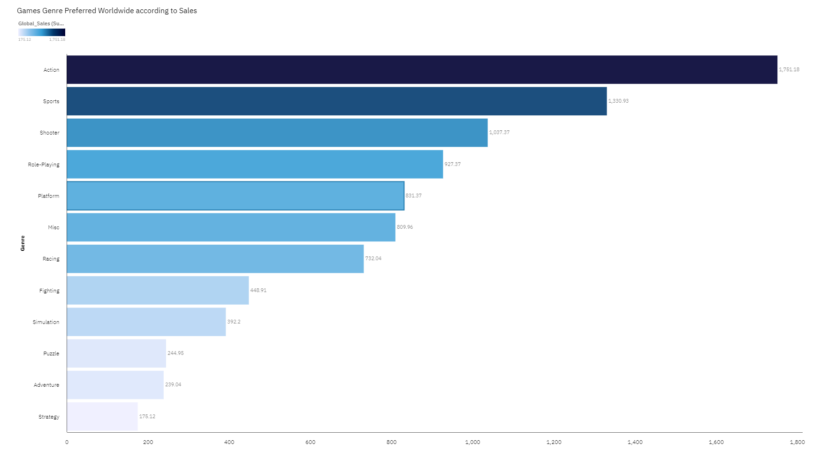
9.Genre (Worldwide)

Slide 13
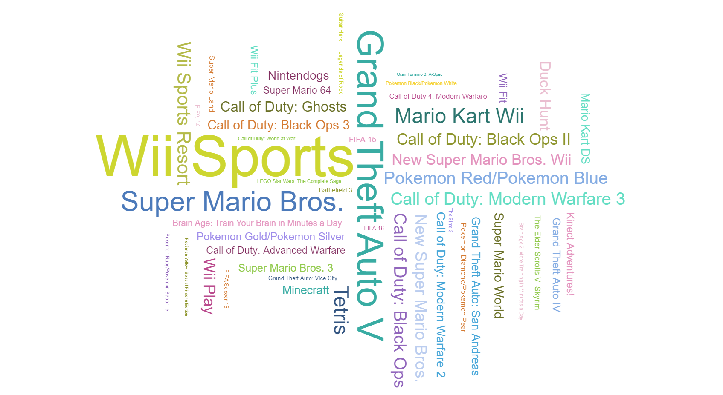
10. Word Cloud

Slide 14
Conclusion
Most Prominent Highlights
Action is the most played genre worldwide.
Nintendo is the top publisher worldwide with around 1.7 billion dollars in sales.
DS and PS2 are the most preferred platforms by users and most games are developed for these two platforms.
Wii Sports is the most played game globally.
North America has the highest number of game sales each year, hence we can say that most users who play games are in North America.
Year 2008 has the highest game sales in the span of 40 years (1980-2020).

